Slide 1
Partners and Objectives
Partner Roles and Responsibilities
Thursday, November 14, 2024

Slide 2
Higher Learning Institutions
College of Lake County
Northeastern Illinois University
Rosalind Franklin University
Southern Illinois University
Education/Cultural Organizations
Community
Partners
(Non-LEA)
(Original Grant Partners)
Boys and Girls Club of Lake Co.
Lake Co. Health Department
Lake Co. Regional Office of Ed.
Local Learning
Mano a Mano Family Resource Ctr.
North Chicago Comm. Partners
Together for Childhood Network
YWCA of Metro Chicago (Lake Co.)

Slide 3
The College of Lake County (CLC) is a public community college in Lake County, Illinois whose primary campus is in Grayslake and two other campuses are in nearby Waukegan and Vernon Hills. It enrolls about 15,000 students in transfer programs, career programs, GED and adult basic education, non-credit and career development, and training for businesses.
Community Partners
(Non-LEA)
Higher Learning Institutions
Northeastern Illinois University (NEIU) is a public university in Chicago, Illinois. NEIU serves approximately 9,000 students in the region. The main campus is in the community area of North Park with three additional campuses in the metropolitan area. The University offers more than 40 undergraduate degree and certificate programs and more than 50 graduate degree, certificate, licensure, and endorsement programs.

Slide 4
Rosalind Franklin University of Medicine and Science (RFU) is a private graduate school in North Chicago, Illinois. It has more than 2,000 students in six schools. RFU offers more than 30 graduate programs in health-related subjects, including PhD programs for medical and basic research.
Community Partners
(Non-LEA)
Higher Learning Institutions
Southern Illinois University (SIUC) is a public research university in Carbondale, Illinois. Chartered in 1869, SIUC enrolls students from all 50 states and more than 100 countries. In 2013, 237,000 residents of central and southern Illinois benefited from 578 initiatives with more than 3,000 community partners.

Slide 5
Boys & Girls Club of Lake County has a rich history of providing essential services to young people in the Waukegan area. Building Great Futures Since 2000, Boys & Girls Club of Lake Co. has positively impacted the lives of over 11,000 young people and their families as a vital resource for the community, offering a safe and nurturing environment where young people can thrive.
Community Partners
(Non-LEA)
Education/Cultural Organizations
Lake Co. Health Department provides residents with convenient access to the services they need to lead healthy and productive lives. The largest human service provider in Lake Co. believes that services must be available without barriers. No residents are turned away due to an inability to pay. They provide services in an environment of mutual respect, free of discrimination or bias.

Slide 6
Lake Co. Regional Office of Educations' mission is to serve as an advocate for education by providing effective leadership, performing regulatory functions in partnership with the Illinois state board of education as directed by the School Code of Illinois, coordinating and delivering state and local services, and disseminating information to educators, school districts, and the community.
Community Partners
(Non-LEA)
Education/Cultural Organizations
Local Learning serves a network interested in engaging young people and citizens with their own traditional culture and with the local culture and folklore of their families, regions, and the larger world. They are folklorists, folk artists, and educators. They work in public agencies, nonprofit organizations, schools, universities, museums, community centers, libraries, and out-of-school education settings.

Slide 7
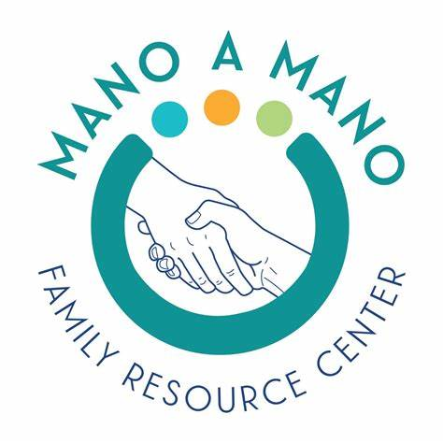
Mano a Mano Family Resource Center is a partnership between local legislators, community leaders, and law enforcement who witnessed a significant need for the local growing immigrant community to have linguistically and culturally relevant supportive services. They offer a variety of resources and services, including health resources, educational classes and workshops, and immigration legal services. Its focus is on helping the hardest-to-reach and most vulnerable families and individuals in the community.
Community Partners
(Non-LEA)
Education/Cultural Organizations
North Chicago Community Partners uses a holistic approach to bridge the opportunity gap and support children in North Chicago by leveraging resources from within and around the neighborhood. Since 2008, NCCP has provided an array of supports, from after school programming and family events to teacher care and annual physicals.

Slide 8
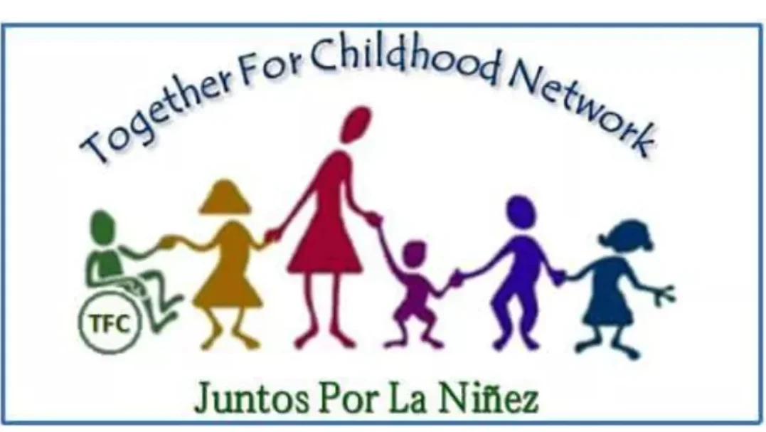
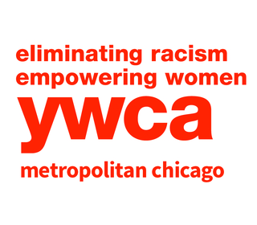
Together for Childhood Network is a not-for-profit national and statewide organization for early childhood educators, childcare providers, preschool teachers, babysitters, parents and community members. Their vision is to provide more resources for providers and parents.
Community Partners
(Non-LEA)
Education/Cultural Organizations
YWCA of Metro Chicago (Lake Co.) is among a national network, YWCA Metro Chicago impacts tens of thousands of women and families annually through comprehensive human services provided across the region. They are a leading service provider in the areas of sexual violence support services, early childhood and childcare provider services, family support services, youth STEM programming, and economic empowerment services.

Slide 9
Each Objective is about the
Development and Implementation of:
First Objective: Systems of Collaboration
Second Objective: Early Childhood
Third Objective: High-Quality School and Out-of-School Time
Fourth Objective: Transitions
Fifth Objective: Family and Community Engagement
Sixth Objective: Social, Emotional, Health
Six Objectives
Full-Service Community Schools (FSCS) Grant

Slide 10
First Objective: All 12 non-LEA Community Partner have a role and responsibility for this objective.
Participate in all relevant team meetings, assist in the planning and coordination of activities, support ongoing needs assessments related to their service area, contribute to planning for sustainability beyond the grant period, engage in and support evaluation activities, especially as it relates to formative feedback and ongoing program improvement.
For this…..we thank you all!
First Objective:
Systemic Culture of Collaboration and Evaluation

Slide 11
Lake Co. Regional Office of Ed.:
Provide early childhood home visits and assessment. Provides support to young families to locate early childhood resources centers and school districts services.
Mano a Mano Family Resource Ctr.:
Provides programs for children ages 5 -12 with opportunities to play, learn, and grow in a safe and healthy bilingual/bicultural environment, while their parents are at work or school.
Together for Childhood Network:
Early Learning Academy Safe Start Programs serving low-income families, providing quality and bilingual early childhood education for children, ages 2 to 5. Offers full-day Head Start/IDHS childcare year-round and provides support to parents. Safe Start provides safety/well-being supports birth to age 5.
Second Objective:
High-Quality Early Childhood Education Programs

Slide 12
Boys and Girls Club:
Provides telecollaborative arts & cultural projects. After-school support. Provides mentoring to youth, homework help, while participants engage with art, peers, social support, and receive healthy meals, school tutoring, and community enrichment programs.
Lake Co. Regional Office of Ed.:
Provides outreach programs for students ages 8 to 12 with the opportunity to career explorations.
Local Learning:
Provides in/after-school arts classes, Professional Development for educators, parent/family workshops, and leadership training respecting the traditional arts and knowledge as critical tools for transformative solutions.
Northeastern Illinois University:
Provides Professional Development on STEM activities (coding and robotics), arts activities, teambuilding for educators.
Rosalind Franklin University:
Provides STEM school and summer activities such as careers in healthcare and mentorship.
Third Objective:
High-Quality School and Out-of-School Time, Expanded & Enriched Programs, Strategies and Learning Time

Slide 13
College of Lake County:
Provides programs that support students and parents to the transition from elementary school through the higher education pipeline.
Northeastern Illinois University:
Provides programs that help with the transition from middle to high, high to college for students participating at the two schools.
Southern Illinois University:
Provides mentorship to students and helps them seeing themselves as successful members of their community.
Fourth Objective:
Supports Children’s Transition from Cradle to Career

Slide 14
College of Lake County:
Provides support for parents, parenting classes, GED, Adult Education and Workforce development, college workshops for students and parents.
Lake Co. Health Department:
Provides free medical care for low-income families, and free referrals to medical specialists.
Lake Co. Regional Office of Ed.:
Provides support for parents, how to understand your student rights and responsibilities.
Local Learning:
Provides Parent/Family workshops that include performing arts, visual arts, leadership, technology, social skills, &
career readiness.
North Chicago Community Partners:
Provides engagement with art, peers, social supports, and receive healthy meals, school tutoring, and community enrichment programs
Fifth Objective:
Family and Community Engagement and Supports

Slide 15
Northeastern Illinois University:
Provides workshops for family and community engagement, leadership, STEM, and teambuilding.
Mano a Mano Family Resource Ctr:
Provides support for behavioral health, mental health, substance abuse, housing security, GED, Adult Education, & workforce development.
Rosalind Franklin University:
Provides free medical screenings to families, free flu and Covid vaccines.
YWCA of Metro Chicago (Lake Co.):
Provides support for behavioral health, mental health, substance abuse, housing security, nutrition parenting classes & workforce development. Provides workshops for professionals and community members and offers dedicated events aimed at raising awareness about mental health.
Fifth Objective:
Family and Community Engagement and Supports

Slide 16
Boys and Girls Club of Lake Co:
Provides a safe and nurturing environment for children and youth in need, at no cost to families. Participants engage in art, social support, and receive healthy meals, school tutoring, and community enrichment.
Lake Co. Health Department:
Provides mental health counseling at low cost to low-income families and children. Provides parenting workshops on how to raise healthy children.
Mano a Mano Family Resource Ctr.:
Provides free bilingual services to people who are experiencing verbal, physical, psychological, financial problems. The program serves individuals of all ages who have experienced or are currently experiencing domestic violence. Counselors/
Advocates are specially trained to address the safety needs and concerns of domestic violence survivors in both group and individual counseling.
Rosalind Franklin University:
Provides free mental health support for parents and community members.
YWCA of Metro Chicago (Lake Co.):
Provides behavioral health: mental health, and developmental disabilities. Welfare: Foster care, intact family services, Community Health: food insecurity, obesity, sexually transmitted infections, diabetes, heart disease, and mental health issues. Offers a variety of health education services, cost-free to participants, to address critical community health needs.
Sixth Objective:
Social, Health, Nutrition, and Mental Health Services and Supports

Slide 17
Community
Partners:
Added
Summer 2024

Slide 18
Big Brothers, Big Sisters of Metro Chicago
https://bbbschgo.org/
HACES (Hispanic American Community Education & Services)
https://haces.org/
Healthcare Foundation of N. Lake Co.
https://www.hfnlc.org/
Community
Partners
(Additional Partners)

Slide 19
IEL (Institute for Educational Leadership)
https://iel.org/
Lake Co. Chamber of Commerce
https://www.lakecountychamber.com/
Lake Co. Forest Preserve
https://www.lcfpd.org/
Next Level Soccer Academy
http://www.nlsacademy.com/
Community
Partners
(Additional Partners)

Slide 20
Nicasa
https://nicasa.org/
North Chicago Library
https://www.ncplibrary.org/
Northern IL Food Bank
https://solvehungertoday.org/
Community
Partners
(Additional Partners)

Slide 21
Puro Futbol
https://purofutbolonline.com/
University of Illinois Extension
https://extension.illinois.edu/
United Way of Lake Co.
https://www.liveunitedlakecounty.org/
Youth Build Lake Co.
https://yblc.org/
Community
Partners
(Additional Partners)

Slide 22
Thank you!
Dr. Mytzy
Rodriguez-Kufner, Program Director
We couldn’t do it without you!
We’ll be talking and meeting throughout this school year and calendar year 2025

