Slide 1
Welcome Partners!
Thank you for joining us!
Enjoy a little breakfast and get to know your fellow partners!
Thursday, November 14, 2024

Slide 2
Welcome
Dr. Mytzy
Rodriguez-Kufner, Program Director
Full-Service Community Schools
need our Community Partners!
Notes:
Welcome partners- read who is in the room have them stand up.
Why we are here today- Story about community
A young 6 yearold immigrant child attends school for the first time in the United States in Chicago. She doesn’t know the language and follows along by observing her peers and her teacher. Her teacher Ms. Zarnowski, helps guide her along, throughout her first grade year, she remembers having accidents because she was too shy to speak as she does not know the language. Her mom comes often and with a dictionary in hand. Her teacher is patient and within that first year, she is reading and writing. She has learned songs, she has gone on fieldtrips, she has made friends. She learns later on from her mom, that there was more than just a teacher and mom working together to make this possible. Her mother had gotten work and assistance on how to work with her child from the teacher. The secretaries were also helpful in making sure that there were clothes for her at school. Sometimes she forgot her lunch and her working dad with the only car couldn’t take her lunch and so she got food at school. The power of community helped this current Doctor succeed. This was back in 1980. Throughout my life through I have been part of various communities that helped me get to where I am.
However, I have also seen the power of a community school in rural towns such as the one my children grew up in. Food, clothing, sponsorship for different activities was provided by businesses, parents, the local college, and other organizations. All children received equitable support for their support. Recently I have seen the power of community in the Grand Rapids, MI area, as well as in Skokie, IL. Both are working with organizations, individuals, and schools just like all of us here.
With that I want to welcome you to our very first Partners meeting. Today we will hear from three individuals who work with organizations that embrace the community mindset model. I also want to welcome and highlight each organization here with us today. When I read your organization’s name, please stand up.
Thank you for being here with us today, it means a lot to us that you have provided support for establishing the grant and that you have worked with us this summer on a few projects. The relationships we are building will help the FSCS El Centro accomplish what was written in the grant.
I want to highlight one of the biggest supporters for the grant. Her work in her community stems from youth. Due to challenges she faced as a student, she has made it her life goal to assist individuals in her community achieve higher education. Without further ado, I present Dr. C. Myra Gaytan-Morales

Slide 3
Opening: At the Center of Community
Dr. Myra Gaytan Morales, Executive Director and Dean
University Center of Lake County
Full-Service Community Schools
need our Community Partners!

Slide 4
Cadence for the Day
Dr. Mytzy
Rodriguez-Kufner, Program Director
Full-Service Community Schools
need our Community Partners!
Notes:
Thank you Dr. Gaytan Morales
Today we will continue to build upon our relationships through different activities. We will allude to what a community grant is, but not go into great detail. We will show you how through different activities.
As you may have noticed we divided you up into different groups. This is so that as we work on activities we already have a groups that represent each organization. Our version of zoom break out rooms.
We will look at four questions that will help you to understand FSCS a bit more. You can answer these questions throughout the time here. Please put those on the sticky pads we have provided for you. We have the poster boards where you can place these responses on the walls there.
We will go through an introduction of what community schools are
Vision casting
Lisa
What we have done with our two district partners and our Next steps
For our partner meetings –
I want to give our Learning Educational Agencies, our districts some time to introduce themselves and highlight something they are most proud of in their educational community.

Slide 5
Grounding Questions
What are your goals for this FSCS grant?
What overarching questions do you have about this FSCS grant?
What impact do you hope to have on the communities you serve as the result of this FSCS grant program? On schools? On students? On families? On teachers? On administrators?
What other questions do you have about your role?
Notes:
Add more questions here David & Heather
Margaret leads
Maybe add a QR code for them to answer (before and after like Dan Duncan does on his vitual meetings)

Slide 6
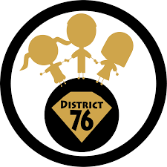
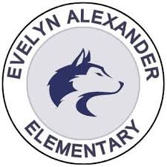
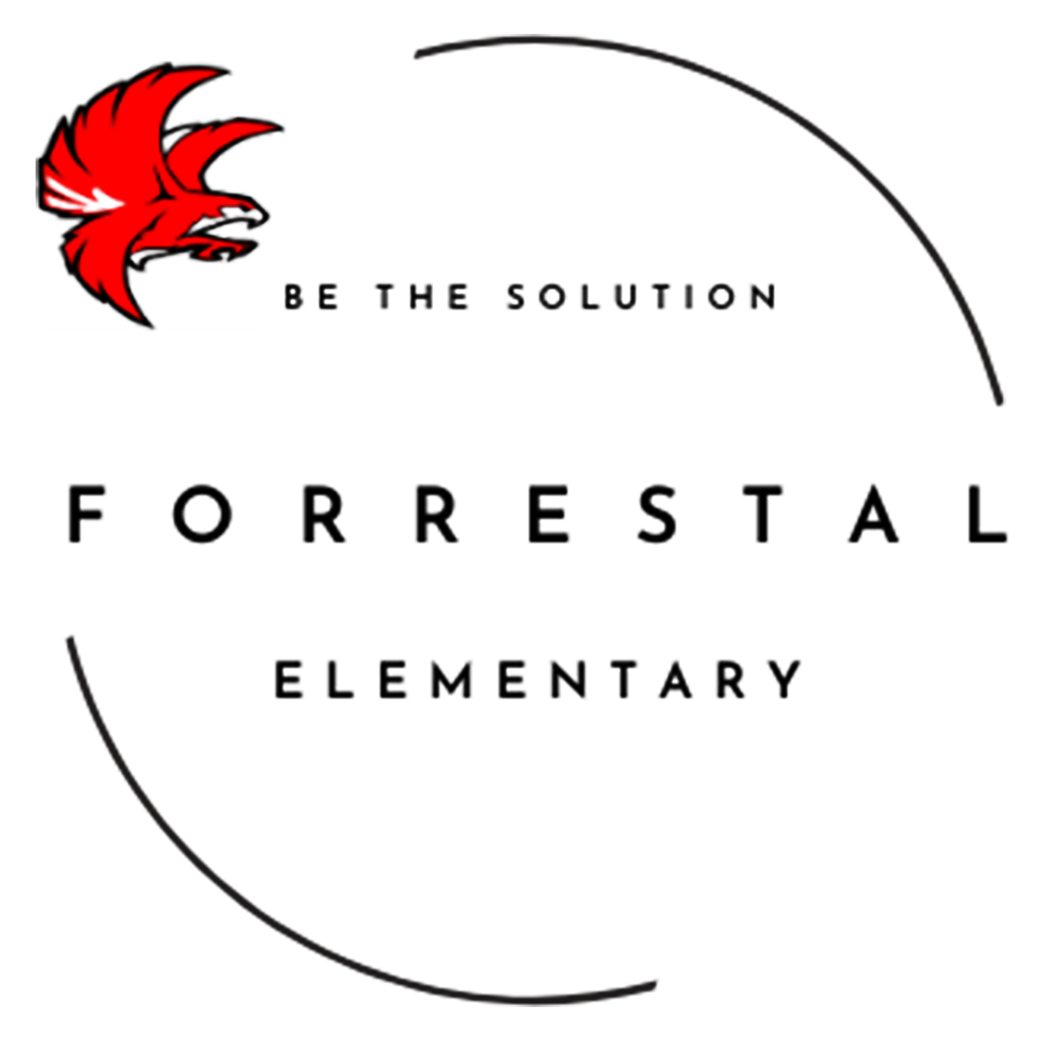
Diamond Lake School District 76 in Mundelein
Diamond Lake Elementary
West Oak Intermediate
West Oak Middle
Participating Schools
Local Educational Agencies (LEA)
North Chicago School District 187
Evelyn Alexander Elementary
Forrestal Elementary

Slide 7
The Power of Community
Margaret Boyter-Escalona, MA
Education Consultant, Complement Consulting Group
Full-Service Community Schools
need our Community Partners!
Notes:
Thank you Drs. Price, Fuhrer, Mr. Rogers, Sami, Dr. Cunningham for highlighting a little bit about your organizations.

Slide 8
The Power of Community
Presented by Margaret Boyter-Escalona:, MA
Education Consultant, Complément Consulting Group

Slide 9
Icebreaker Activity / Conversation Starter
Turn to a partner and discuss these questions.
*What is a community?
*What communities do you belong to?
*What makes these groups communities?

Slide 10
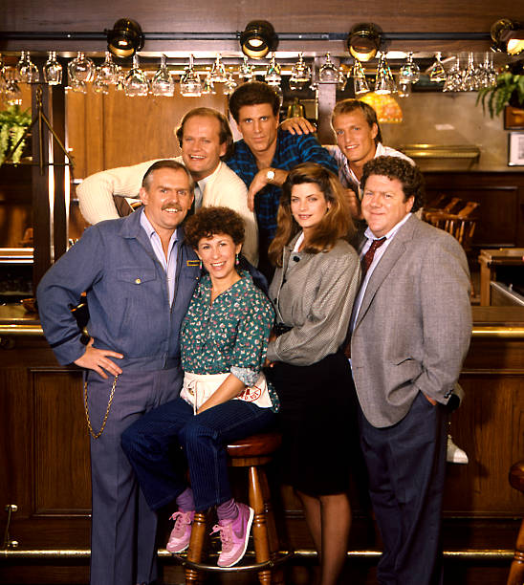
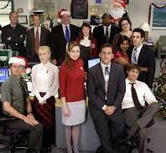
Examples of Communities From Mainstream Media
The community of:
* the local watering hole (Cheers)
* The workplace (The Office)
* The school (Abbott Elementary)

Slide 11
How do these examples and your discussions demonstrate the concept of COMMUNITY?

Slide 12
The Benefits of Community Schools
*Transform traditional public schools into neighborhood hubs that mobilize students, educators, staff, partners, families & community members to reimagine education and co-construct a shared vision for their school and their community.
*Form a core element of an equity strategy. All children and families benefit from access to resources, opportunities and supports to advance learning and healthy development.
*Tap into a community’s assets – from nonprofits, cultural organizations and businesses - to bring enhanced learning opportunities to under-resourced schools reducing the achievement gap, the inequities in student performance on test scores, grades, attendance, and social emotional attitudes that result from lack of access.

Slide 13
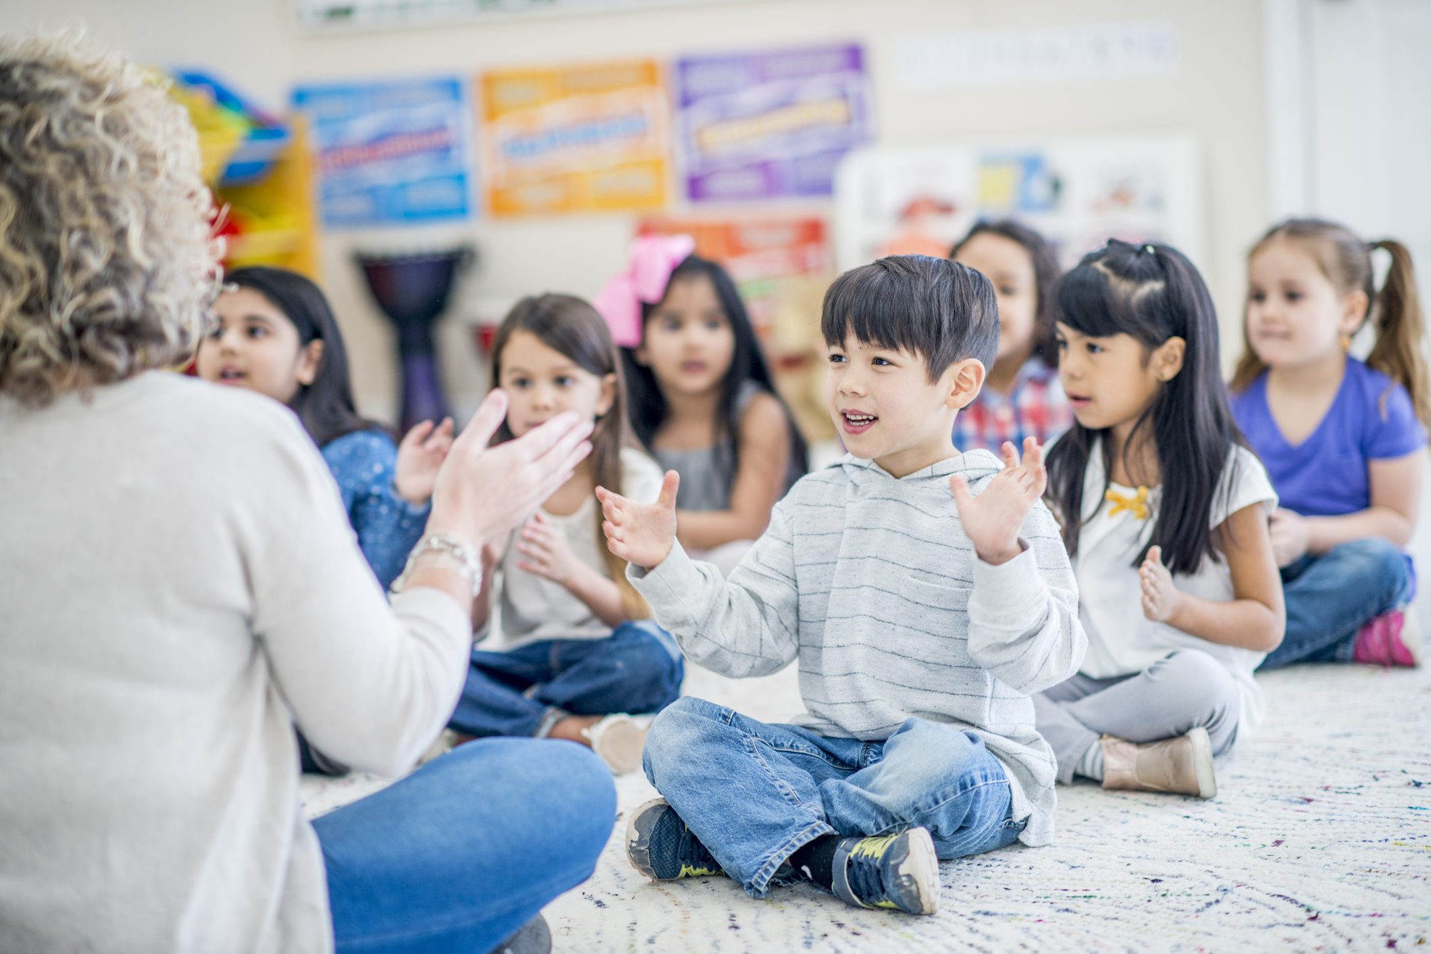
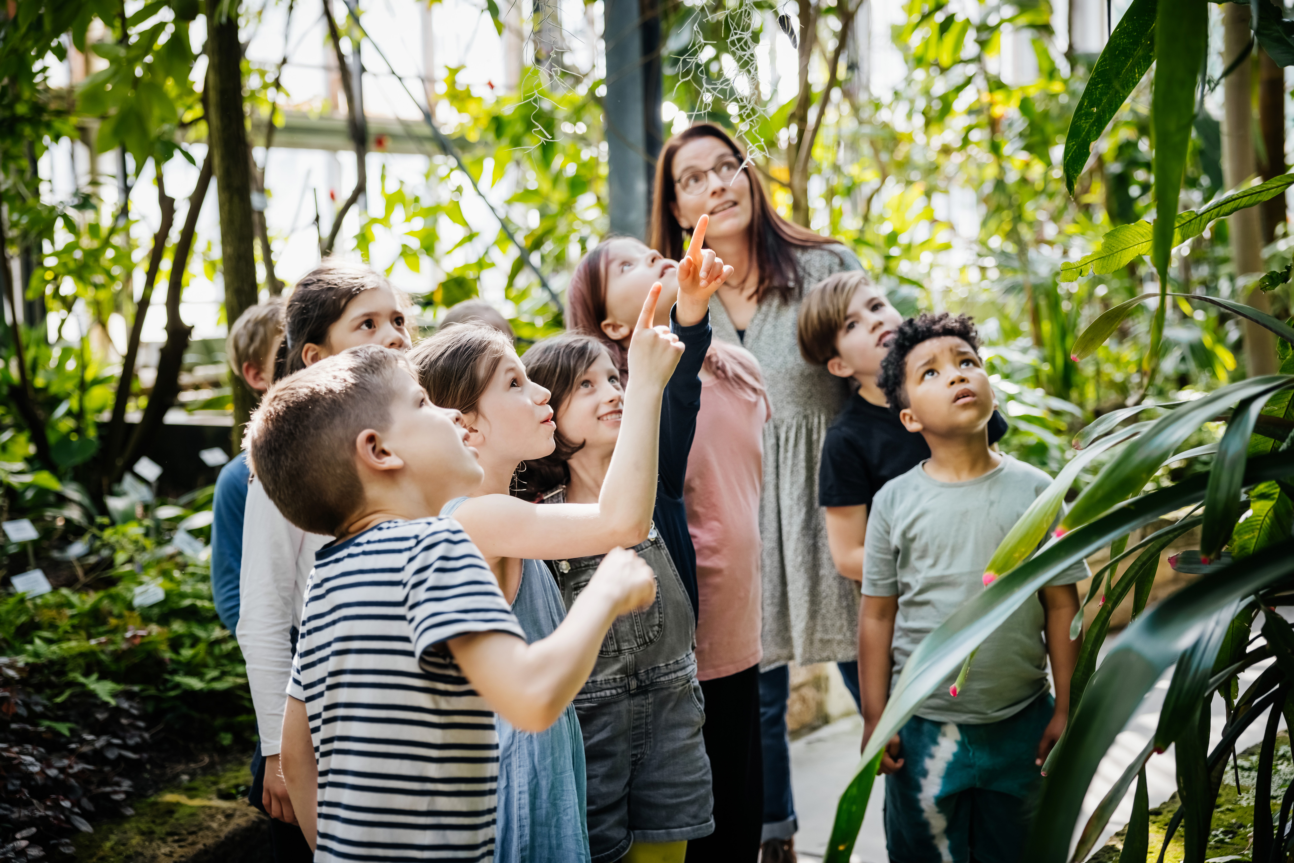
Successful Community Schools
Capitalize on local assets of the entire community including the gifts and talents of people who live and work there-parents, families, educators, school staff, and community partners.
Create and maintain a rich academic focus.
Provide sufficient time and depth on arts and culture & on social-emotional domains.
Use quantitative and qualitative data to inform practice and inform funders.

Slide 14
How Community Partners Shape this Full-Service Community Schools Grant
● Collaborate with park districts, cultural institutions, higher education institutes, health centers, nonprofits, & others to support enrichment for students and families.
● Welcome District Superintendents & Principals to share their expertise and knowledge of the needs of students, families, and teachers to create relevant programs meeting the funded goals and objectives..
● Evaluate the success of the grant using school & district data, administer surveys to, teachers, students, after-school instructors, & families in the reports to the U.S. Dept. of Education to support continuous improvement, & provide a feedback loop for all partners.

Slide 15
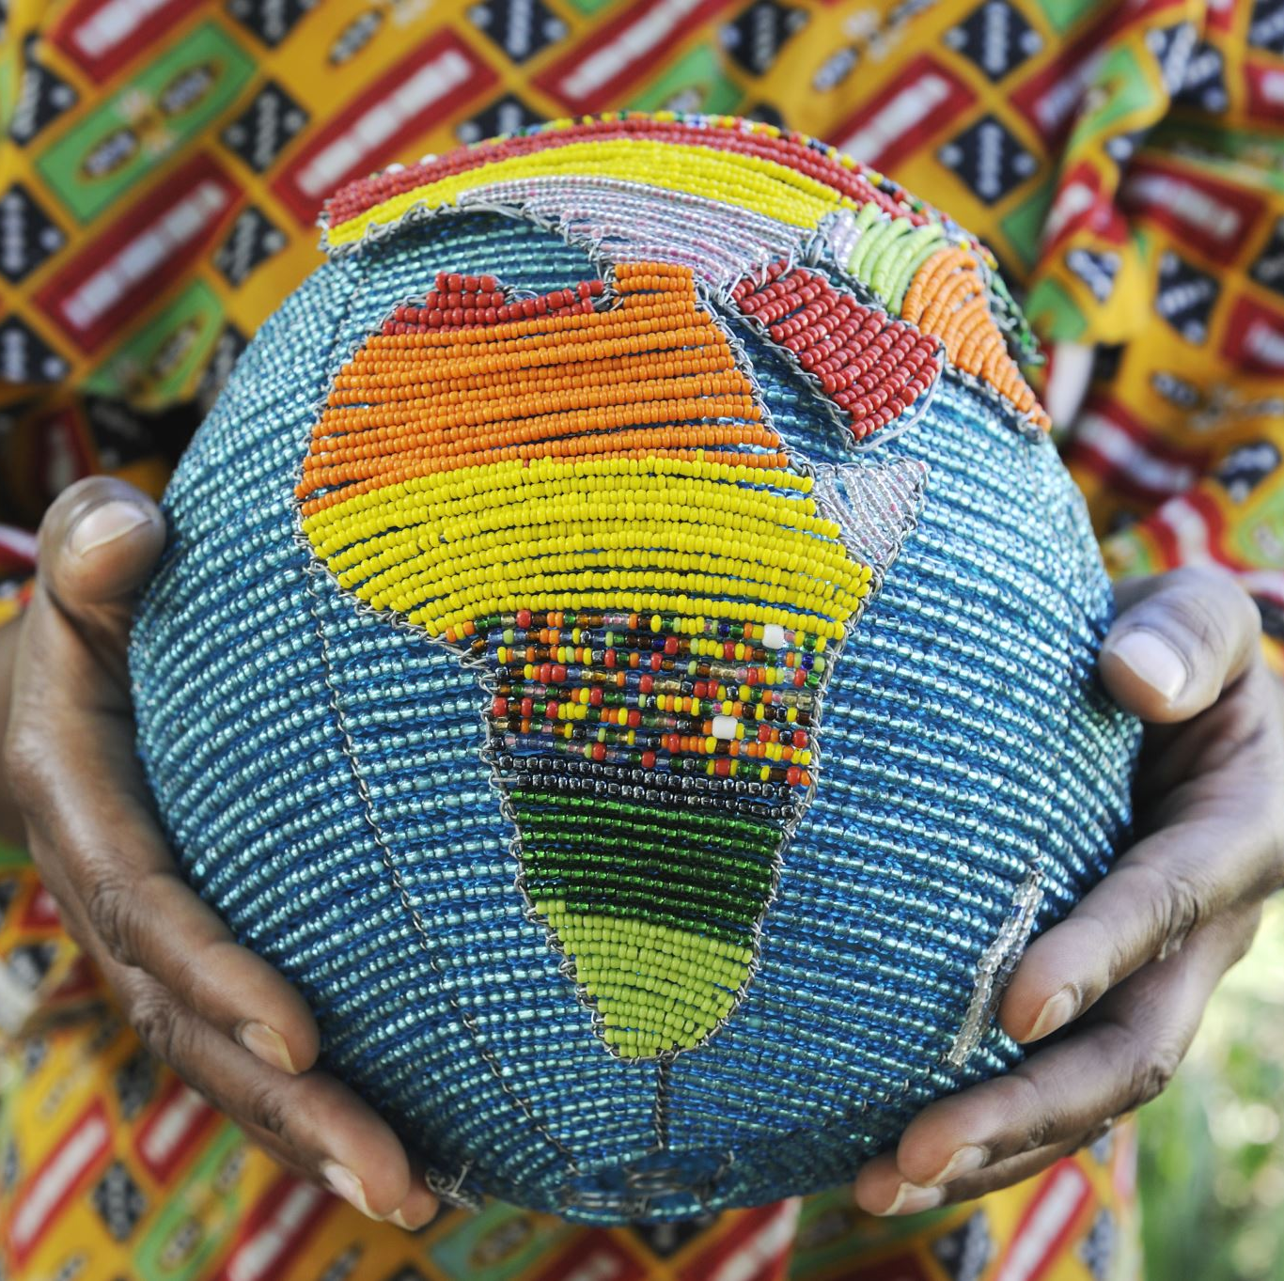
Creating the Conditions for Community
Adopt the African concept of Ubuntu: an authentic individual human being is part of a larger and more significant relational, communal, societal, environmental and spiritual world.
Ubuntu encompasses the interdependence of humans on another and the acknowledgment of one's responsibility to their fellow humans and the world around them.

Slide 16
Parting Thoughts on the Power of Community as you You Re-imagine Schools
We cannot seek achievement for ourselves and forget about progress and prosperity for our community. Our ambitions must be broad enough to include the aspirations and needs of others, for their sakes and for our own. – Cesar Chavez
Education is for improving the lives of others and for leaving your community and world better than you found it. - Marian Wright Edelman

Slide 17
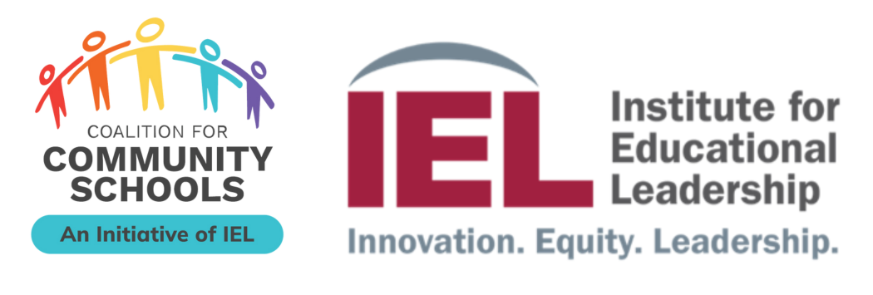
Vision Casting: Community Builder Activity
Dr. Ryan Hurley
Midwest Director
Institute for Educational Leadership
Coalition for Community Schools
Core to all Full-Service Community Schools (FSCS)

Slide 18
What is a Community School?
Notes:
-quick reflection

Slide 19
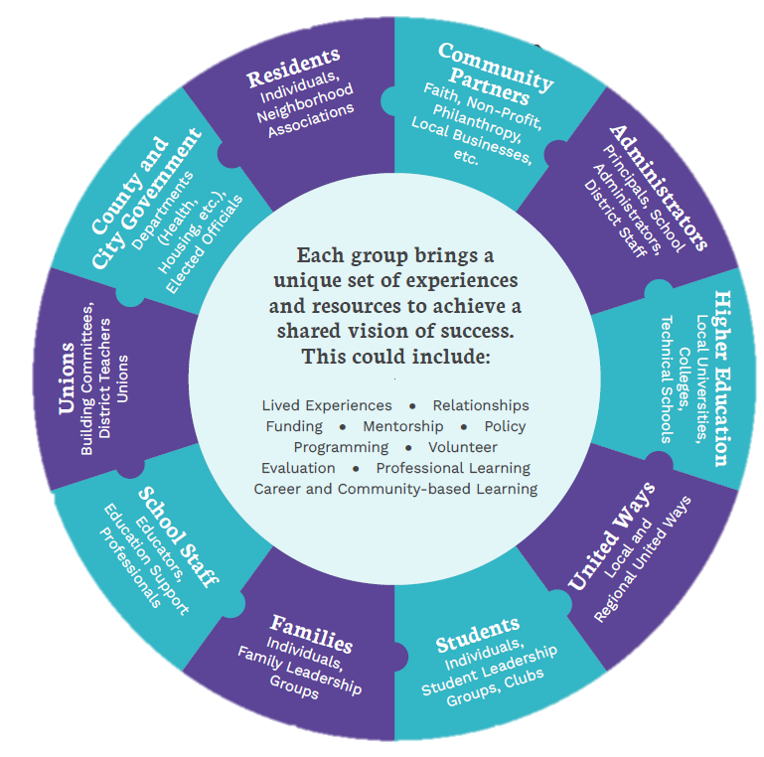
Community Schools are unifying strategy.

Slide 20
Vision Casting
At the core of any worthwhile action is a clear and shared vision.
What is your vision for children and families in your community?

Slide 21
The ABCs of the role of Arts in Building Belonging and Connecting to Community When asked to engage with a school’s community, is it clear who “is” the community? This interactive session will engage cultural mapping through an arts-based lens to better understand the role of cultural identity and group belonging in our school communities.
Dr. Lisa Rathje
Executive Director
Local Learning

Slide 22
What We’ve Done
Dr. Mytzy
Rodriguez-Kufner, Program Director
2024….So Far!
Notes:
As you entered you may have seen poster boards highlighting the work that has been done so far at the schools.
We have worked with students, parents, and the community to highlight both districts.
We have celebrated with our partners at their events.
As of now we have served our families at both districts through partnerships with the schools. We have had a back to school bash at Evelyn Alexander where 150 families showed up. We had a bouncy house, dj, and different organizations that provided information on health and social emotional support. We provided bookbags and some back to school supplies.
At the Hispanic Month Celebration at Forrestal, we had over 200 families show up to hear their children celebrate, we added the Mariachi’s who added an educational twist on what it means to be a Mariachi and businesses also supported us by donating breads.
We have had fieldtrips at the various schools that connect to the strategic goals of the district, the standards the teachers are working on, and most importantly the parental engagement piece. The chaperones at the Apple Holler really enjoyed the time to connect with their children and we got to hear their voices. The petting farm came to the pre-kindergarten students at Diamond Lake in order to maximize their time at school, learning about different habitats.
We have also been able to provide food insecurity assistance by partnering up with the Northern Illinois Food bank with Diamond Lake School District D76.
Our partners with NCCP have been instrumental in helping to provide us with resources to make sure that food insecure parens within Forrestal and E. Alexander have the food and clothing necessary.
Yet, there is still much to do in our communities.
I have been blessed to be part of these two communities. Having worked in Lake County previously, I have contacts that have created their own opportunities to give back to the places they live and work in.

Slide 23
Next Steps
Dr. Mytzy
Rodriguez-Kufner, Program Director
2025 and Beyond!
Notes:
As we end this Department of Education fiscal year 2025, we look forward to beginning our next fiscal year strongly.
We got to think about a shared vision and looked at how to connect community through visuals and the arts.
We will continue to meet as partners three times a year. Although, I will be reaching out to you individually or through other events at your organization.
We will have little mini modules set up on our landing page at the University Center website to help everyone understand Full Service Community Schools.
The mindset of a community school builds slowly and gets engrained through practice. There is the saying that says: “The greatness of a community is most accurately measured by the compassionate actions of its members.” — Coretta Scott King¹
This quote emphasizes the importance of kindness and compassion in creating a strong, supportive community. Does this resonate with what you were looking for?

Slide 24
Thank you!
Dr. Mytzy
Rodriguez-Kufner, Program Director
We couldn’t do it without you!
We’ll be talking and meeting throughout this school year and calendar year 2025

Slide 25
Please fill out our quick Evaluation Click on the QR Code
Evaluation
Our deepest appreciation for coming to our first partners’ event.

